Slide 1

BRITISH AIRWAYS
Data Science: Web scraping to gain company insights
Sept 2023

Slide 2
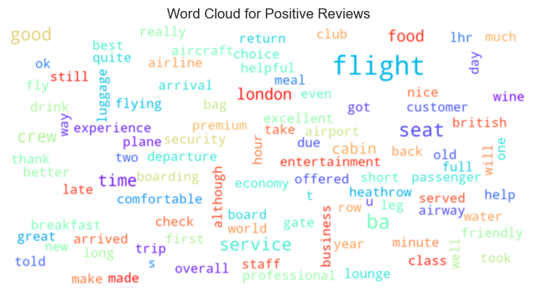
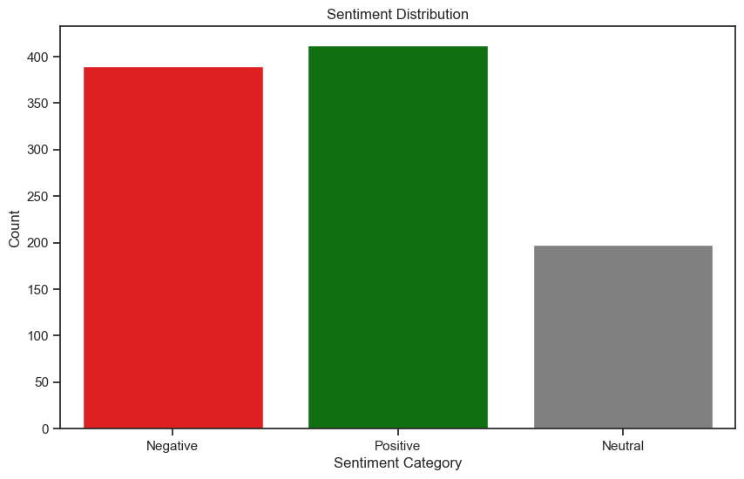
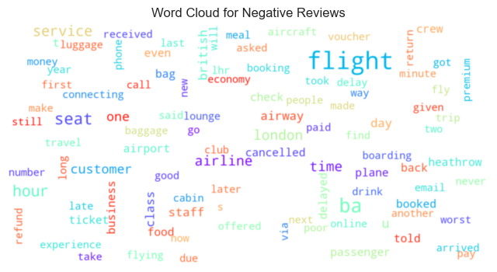
CUSTOMER REVIEW DATA INSIGHTS
Total Reviews collected – 1018 out of 3643
Positive Review - 426
Negative Review - 388
Neutral - 204
Fig 2.1 Positive reviews word cloud
Fig 1 Sentiment Analysis
Fig 2.2 Negative reviews word cloud

